Slide 1

CAPSTONE PROJECT
HOTEL MANAGEMENT SYSTEM
REDDI SANDEEP KUMAR,
ASSOCIATE ENGINEER,
ASCENDION

Slide 2

Problem Statement
The Hotel Management System (HMS) is a comprehensive web-based application designed to streamline the management of hotel operations. It allows administrators to efficiently manage bookings, hotels, guests, facilities, and reviews. The system enables admins to add, update, delete, and view records for each of these entities, with automated features like generating unique IDs for bookings and hotels. With a user-friendly interface built using Angular for the front end, backed by Spring Boot for the server-side logic, and MySQL for data storage, this project aims to enhance the overall management process by providing an easy-to-use, centralized platform.

Slide 3
What is angular?
Angular is a platform and framework for building single-page web applications (SPAs) using HTML, CSS, and TypeScript.
It provides tools for building dynamic, responsive, and structured front-end applications with features like two-way data binding, component-based architecture, routing, and form handling.
In our project, Angular is used to create the user interface, manage interactions, and communicate with the Spring Boot backend via REST APIs to handle the data flow.

Slide 4
What is Spring Boot ?
A Java-based framework used to develop backend services. It simplifies the process of setting up and configuring Java web applications. Spring Boot serves as the backend framework that processes data, communicates with the database, and provides the necessary data or operations to the frontend Angular application.
In this project, Spring Boot is used to:
Define REST APIs (for example, /api/v1/booking, /api/v1/register) to interact with the frontend.
Handle database operations (using JPA/Hibernate to interact with the MySQL database).
Manage business logic (such as generating IDs).

Slide 5
Project Overview
Purpose: To develop a Hotel Management System with functionalities for managing bookings, hotels, guests, facilities, and reviews.
Key Technologies:
Frontend: Angular
Backend: Spring Boot
Database: MySQL
Objective: Provide an efficient, user-friendly system to streamline hotel operations.

Slide 6
Features and Functionalities
Core Features:
User Authentication (Admin Login/Register).
CRUD Operations for Bookings, Hotels, Guests, and Facilities.
Hotel Management.
Search and Filter Options.
Unique Points:
Auto-generated unique IDs for entities.
30-minute lockout for 3 invalid login attempts.
Dynamic updates in the UI integrated with the database.
User not found validation for not registered users

Slide 7
Technologies Used
Frontend:
Angular: Responsive UI, Bootstrap for styling.
Components: Separate components for each module (Bookings, Hotels, etc.).
Backend:
Spring Boot: REST APIs for CRUD operations, layered architecture.
Controllers, Entities, and Repositories.
Database:
MySQL: Tables for register, booking etc.
Workflow:
User interacts with the Angular frontend.
Requests are processed by Spring Boot APIs.
Data is stored/retrieved from MySQL database.

Slide 8
Challenges Faced:
Handling auto-increment IDs dynamically across the backend and database.
UI alignment and responsiveness for various components.
Integrating Spring Boot with MySQL and Angular.
Implementing security features like login attempts and lockouts.
Project Outcomes:
Successfully implemented a full-stack web application.
Enabled seamless communication between frontend and backend.
Achieved dynamic database updates with auto-generated IDs.
Enhanced user experience with a responsive design.
Future Enhancements:
Enable role-based authentication for admins.
Integrate payment gateways for bookings.

Slide 9
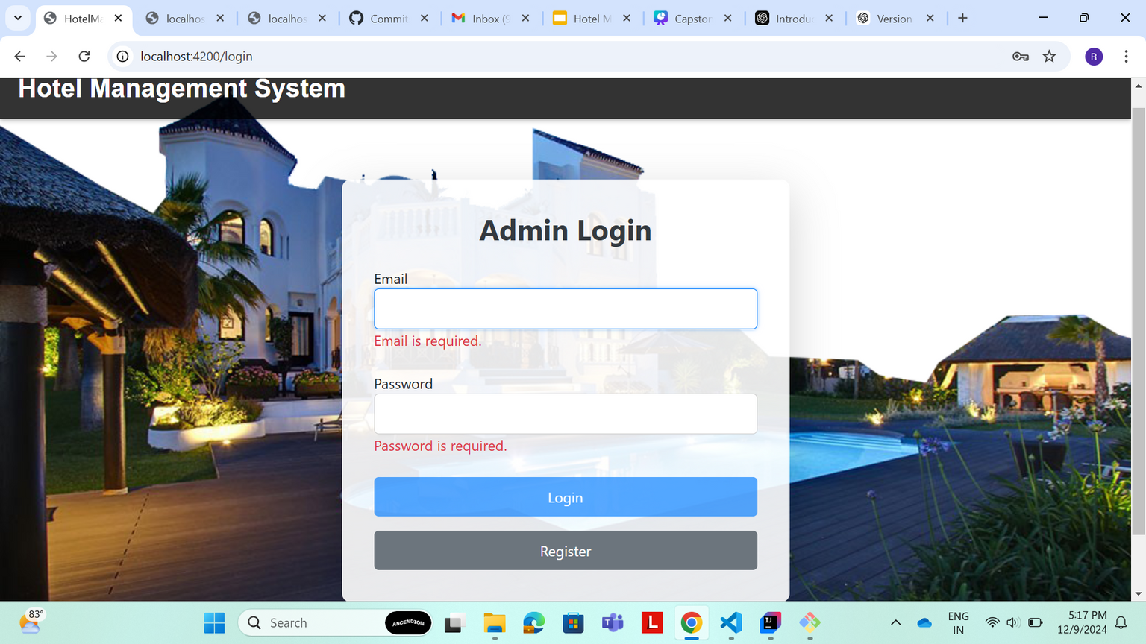
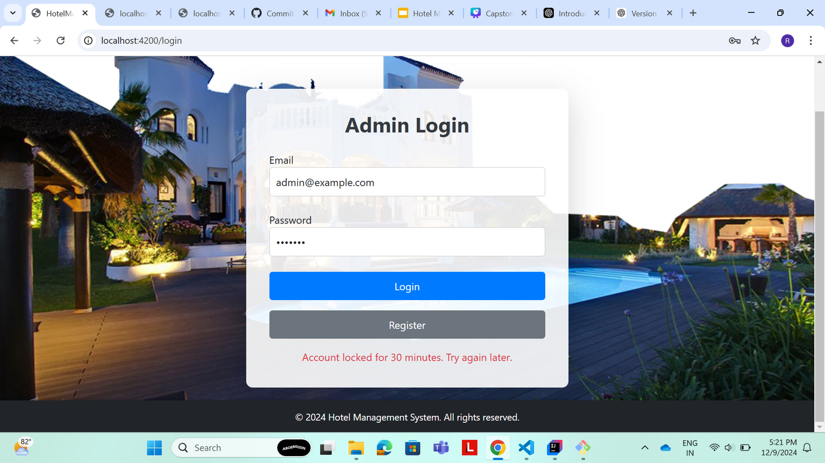
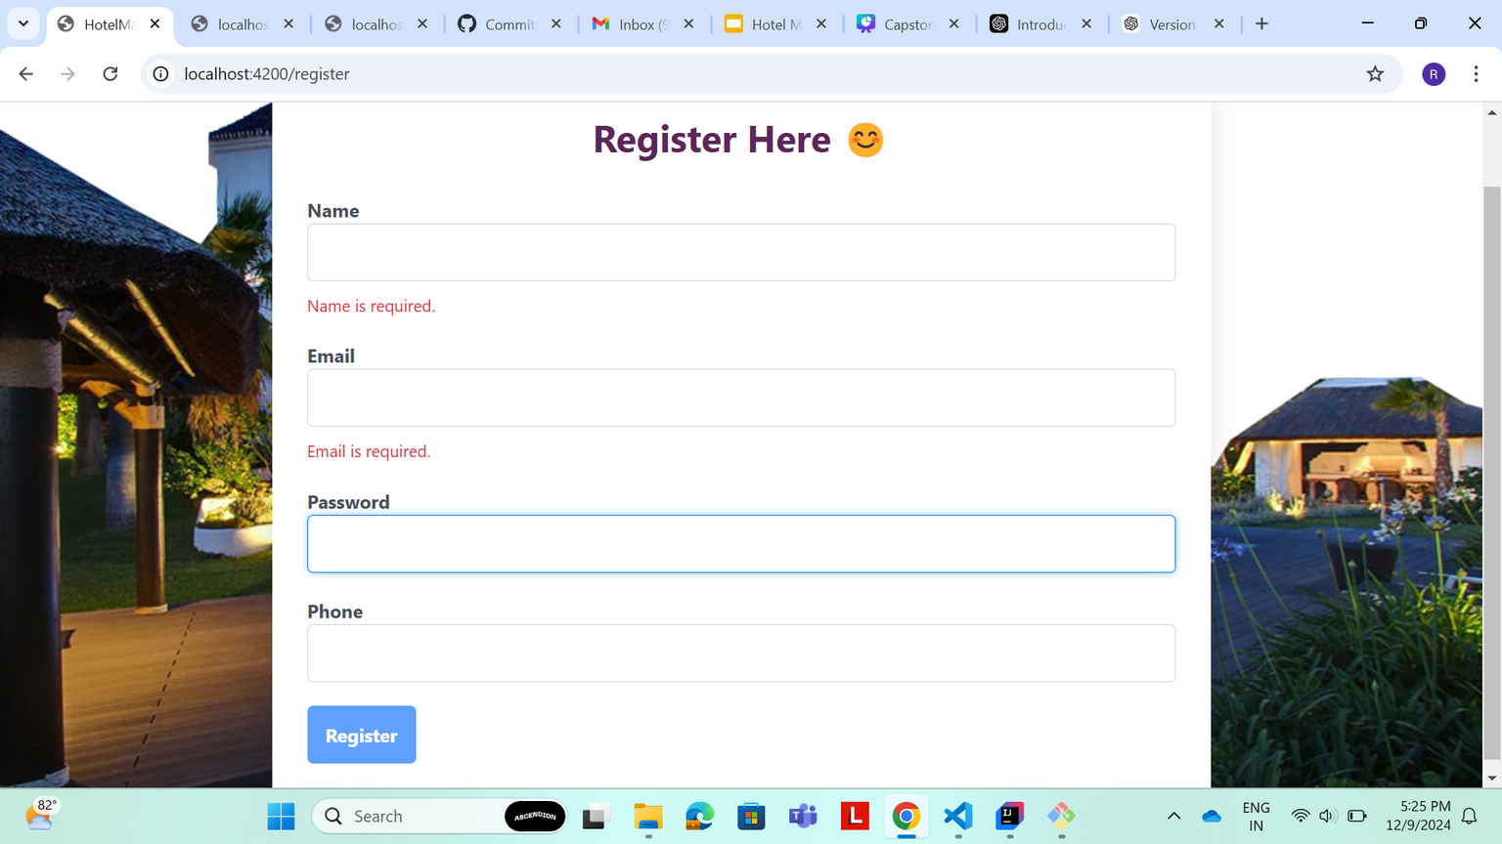
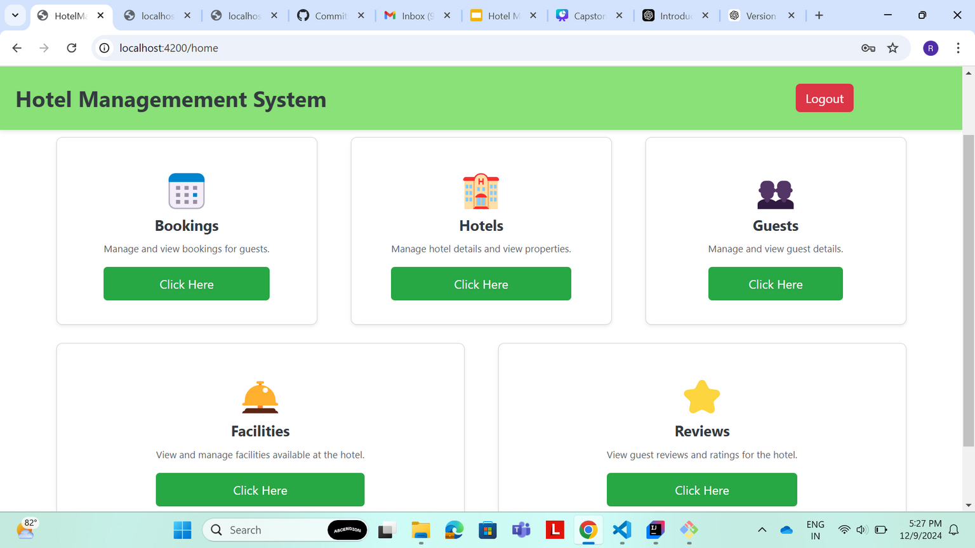

Slide 10
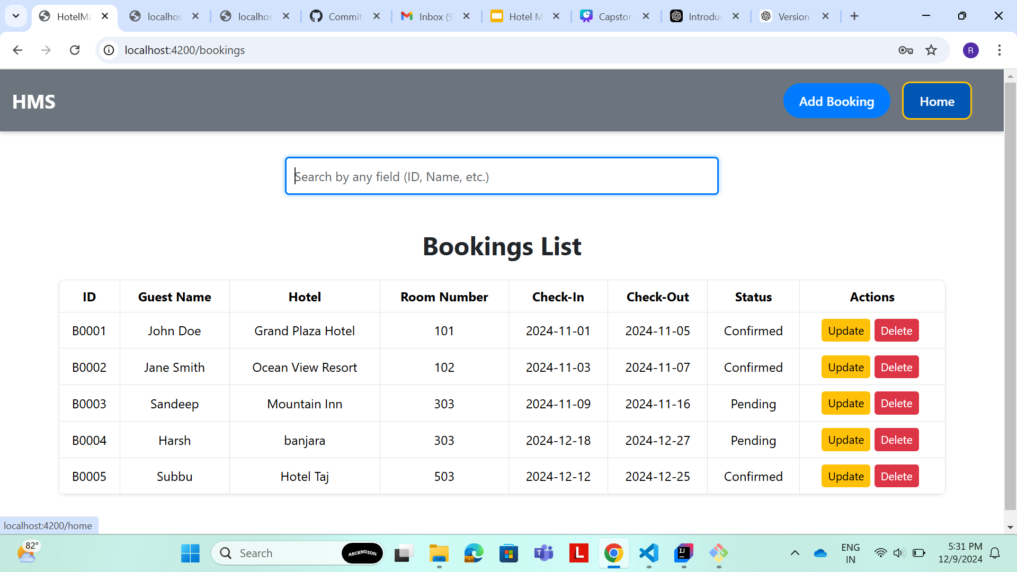
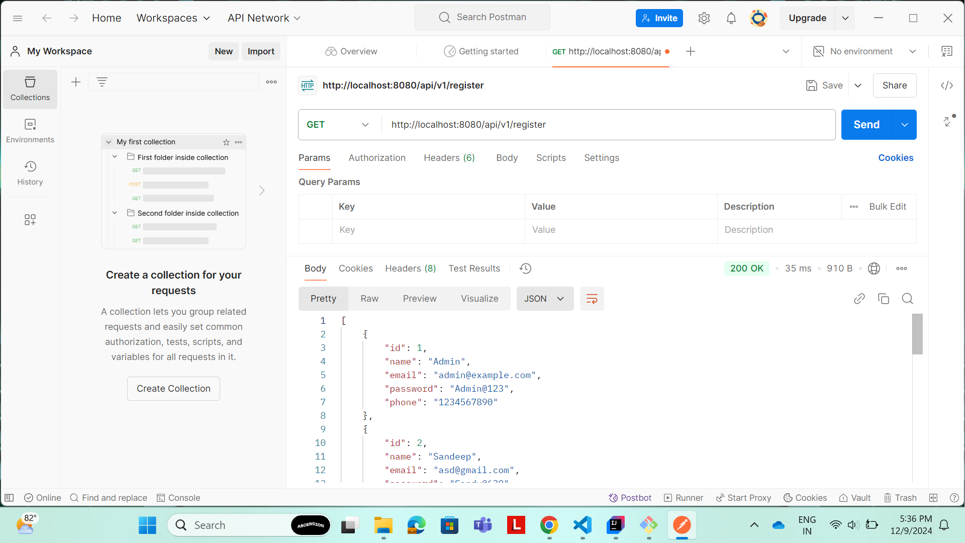

Slide 11
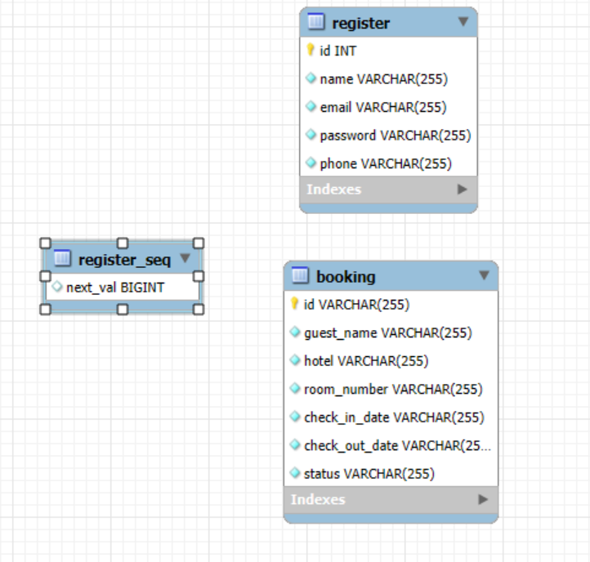
ER Diagram:

Slide 12
Conclusion:
The Hotel Management System project effectively integrates Angular for a dynamic front-end, Spring Boot for robust server-side logic, and MySQL for reliable data storage. This streamlined solution simplifies hotel operations, including managing bookings, hotels, guests, facilities, and reviews. By leveraging modern technologies, the system ensures a seamless user experience, scalability, and maintainability.

Slide 13
Key Takeaways/Learnings from the training Program:
Theory vs Application
Theory into Application
Knowledge vs Experience
Perception to Perfection
Individualism vs Collaboration
Grow through Feedback
Listen-Learn-Lead

Slide 14
Thank you....

